Slide 1
Enabling Robots to Autonomously Build 3D Models of Objects
Michael Krainin
University of Washington CSE
Intel Labs Seattle

Slide 2
Articulated Tracking

Slide 3
Object Modeling

Slide 4
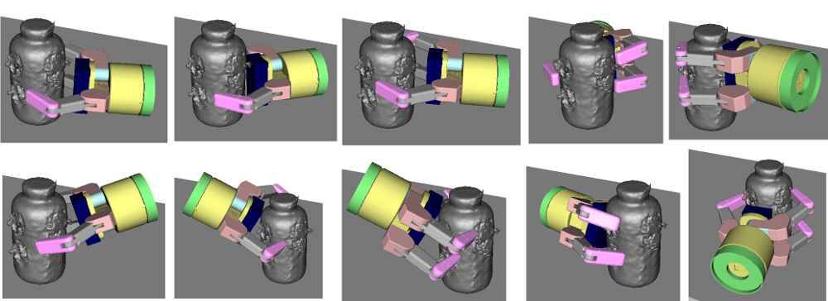
Next Best View

